Slide 1
Cluster Analysis
Clustering Part 1:
How does K means actually work?
“

Slide 2
What is the objective of k means?
There are two main objectives:
Minimize the distance or sum of squares between each data point and the cluster centroid
= centroid
= data point
= distance

Slide 3
What is the objective of k means?
There are two main objectives:
2. Maximize the distance or sum of squares between each centroid

Slide 4
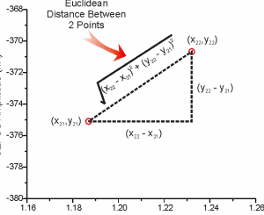
What do we mean by “distance”?
Euclidean distance (most often used)
.

Slide 5
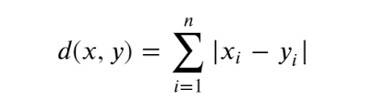
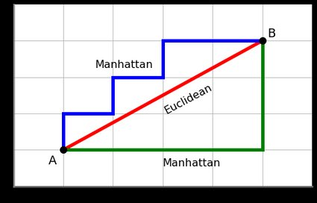
What do we mean by “distance”?
2. Manhatten distance
.

Slide 6
What do we mean by “distance”?
The Mahalanobis distance corrects data for different scales and correlations in the variables. (nasty formula – I won’t abuse you with it…)
and there are more…
.

Slide 7
What are the steps in k means?
You pick the number of clusters k you think is correct
Randomly select k points as cluster centroids
Measure the distance between each data point and each centroid
Assign the data point to the closest centroid
Calculate new centroids
Calculate distance from each data point to new centroid
Assign the data point to the closest centroid
Did any data point change cluster? If no you are done. If yes, then start back at step 5
.

Slide 8
How does this work?
Step 1 – gather data
Here is our data

Slide 9
How does this work?
Step 2 – randomly select data points as centroids

Slide 10
How does this work?
Step 3 – calculate distances to centroids 1 and 2
Dist to centroid 1 = sqrt( (1-1)² + (1-1)² ) = 0
Dist to centroid 2 = sqrt( (1-3.5)² + (1-5)² ) = 7.21

Slide 11
How does this work?
Step 3 – calculate distances to centroids 1 and 2

Slide 12
How does this work?
Step 4 – Assign person to closest cluster

Slide 13
How does this work?
Step 5 – Calculate new centroid
New centroid 1 = (1/3 * (1.0 + 1.5 + 3), (1/3 * (1.0 + 2.0 + 4.0)) = (1.83,2.33)
New centroid 2 = (1/4 * (5.0 + 3.5 + 4.5 + 3.5), (1/4 * (7.0.0 + 5.0 + 5.0 +5.) + 4.5)) = 4.12,5.38)

Slide 14
How does this work?
Step 5 – Calculate new centroid
New centroid 1 = (1/3 * (1.0 + 1.5 + 3), (1/3 * (1.0 + 2.0 + 4.0)) = (1.83,2.33)
New centroid 2 = (1/4 * (5.0 + 3.5 + 4.5 + 3.5), (1/4 * (7.0.0 + 5.0 + 5.0 +5.) + 4.5)) = 4.12,5.38)
Note that person 3 has shifted from cluster 1 to cluster 2

Slide 15
How does this work?
Step 5 – Calculate new centroid
New centroid 1 = (1.25, 1.5)
New centroid 2 = (3.9, 5.1)
Notice that no one has shifted clusters. The clustering is done!

